Slide 1





Baseball and Money
Effect of Money and Star Players on the success of Playoff Teams from 2005-2015
“Dertroit Beisbolcats” Image credit Jeff Arcel at beisbolcats.com
“Money Vectors” Image credit Vecteezy at www.vecteezy.com/free-vector/money

Slide 2
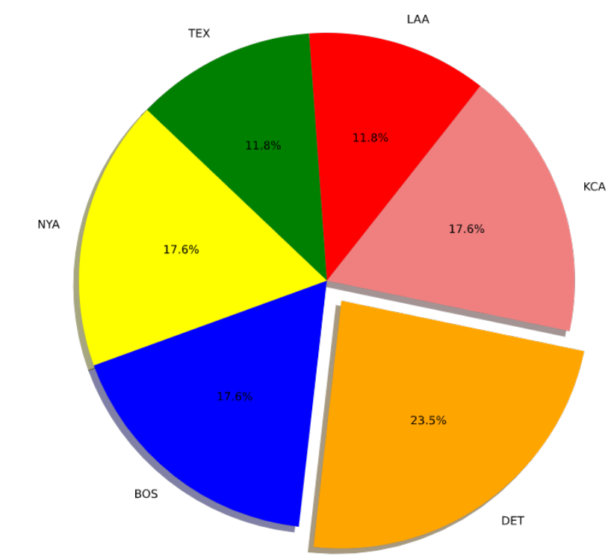
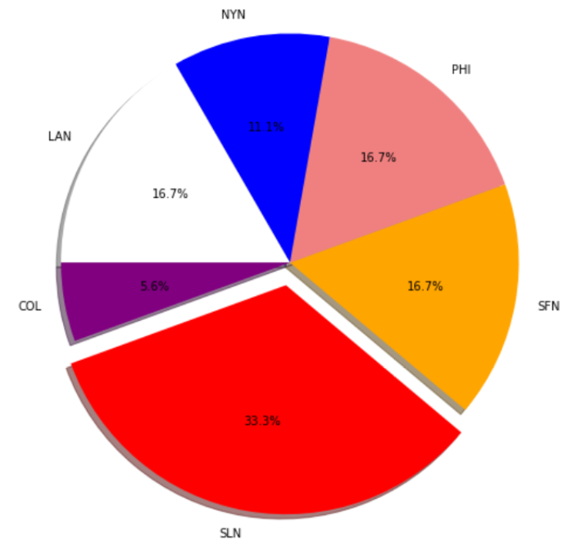
Number of ALCS and NLCS Appearances from 2005 to 2015

Slide 3

Questions
1) For teams that make it to the playoffs, does high spending on player salaries mean they win more often?
2) Do “star players” make a big enough difference that they justify their contracts?
3) Do specific players make a noticeable difference when they change teams?

Slide 4
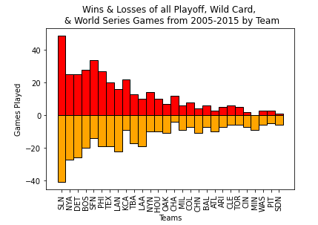
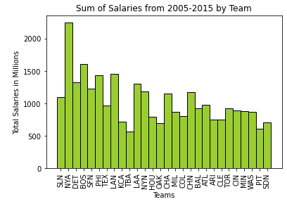
Big Winners and Big Spenders

Slide 5
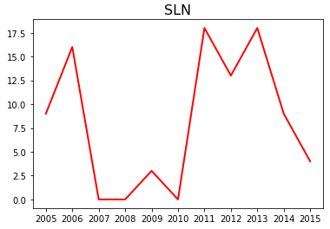
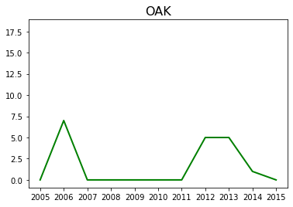
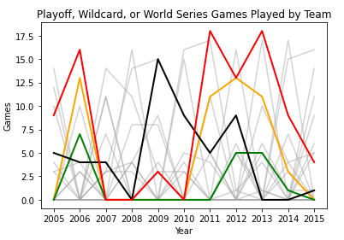
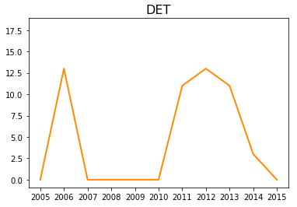
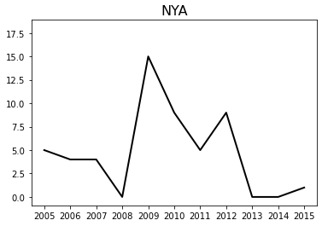
Team Performance over Time

Slide 6
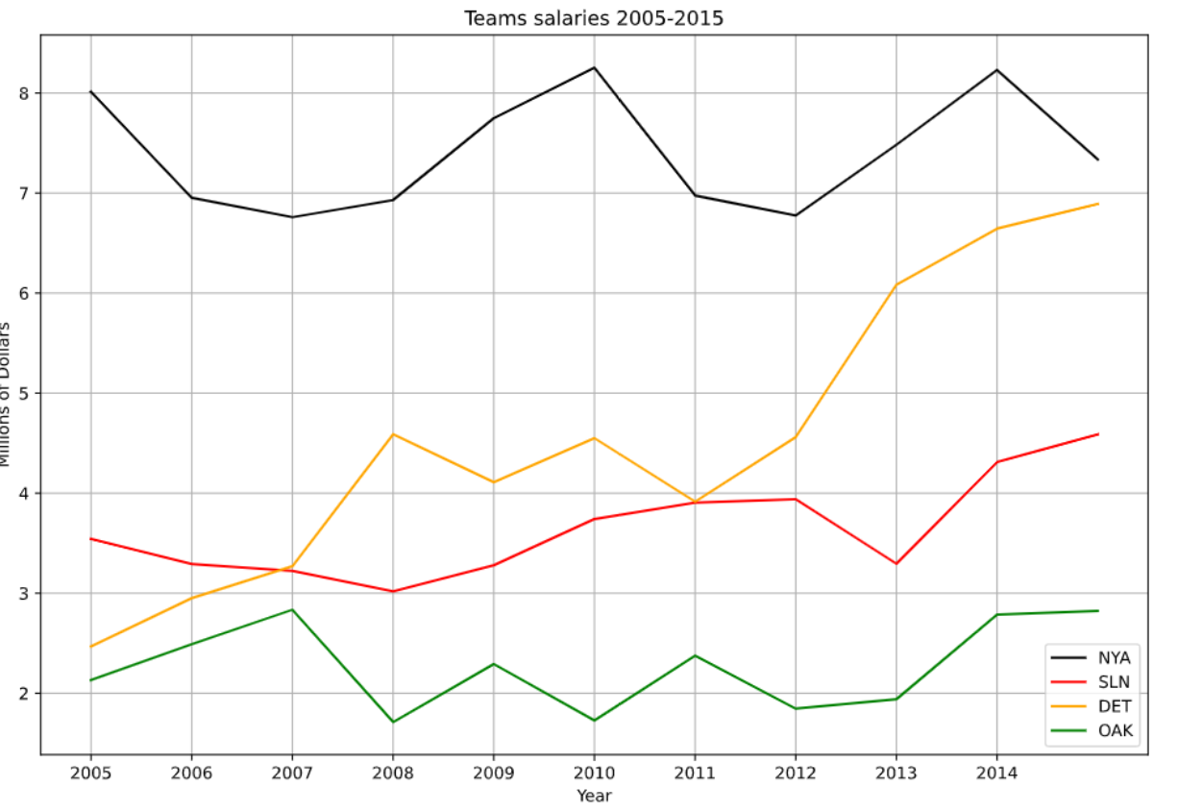
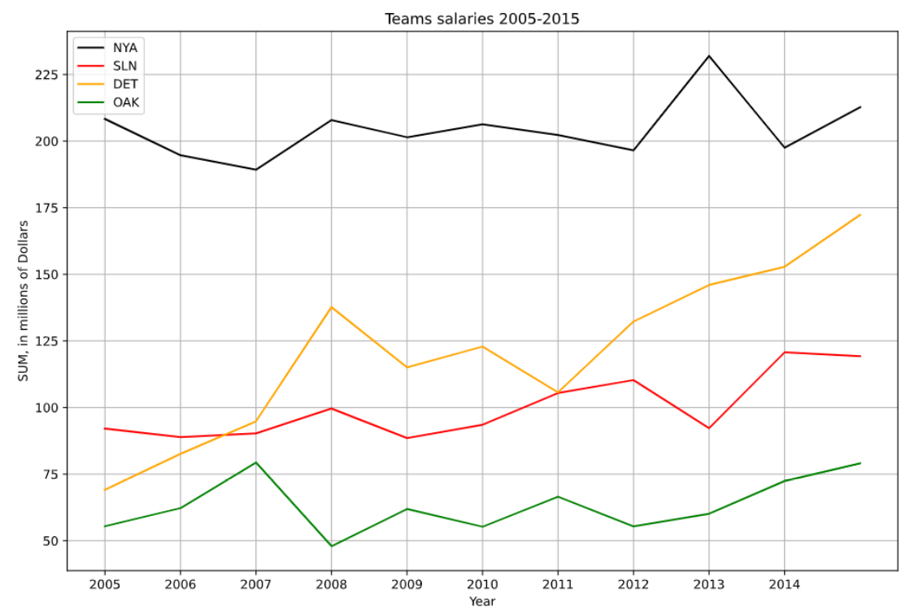
Mean vs. Sum in Team Salaries

Slide 8
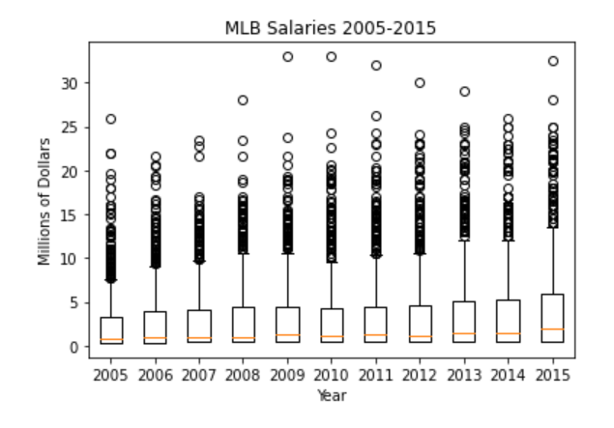
Players Making Cash Money

Slide 9
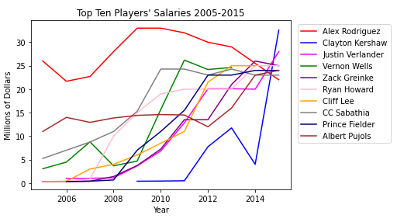

Slide 10
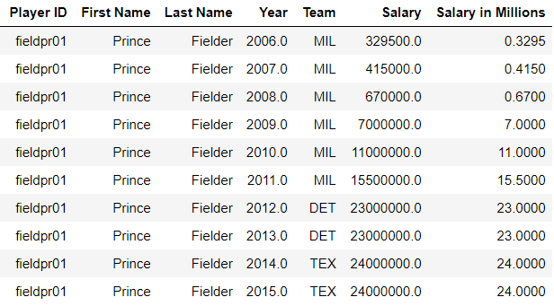
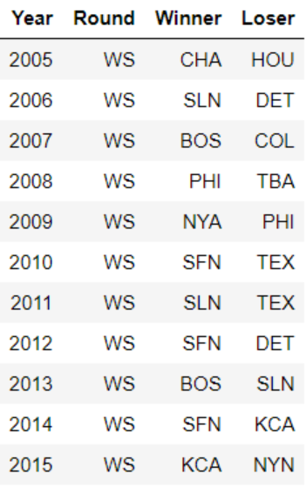
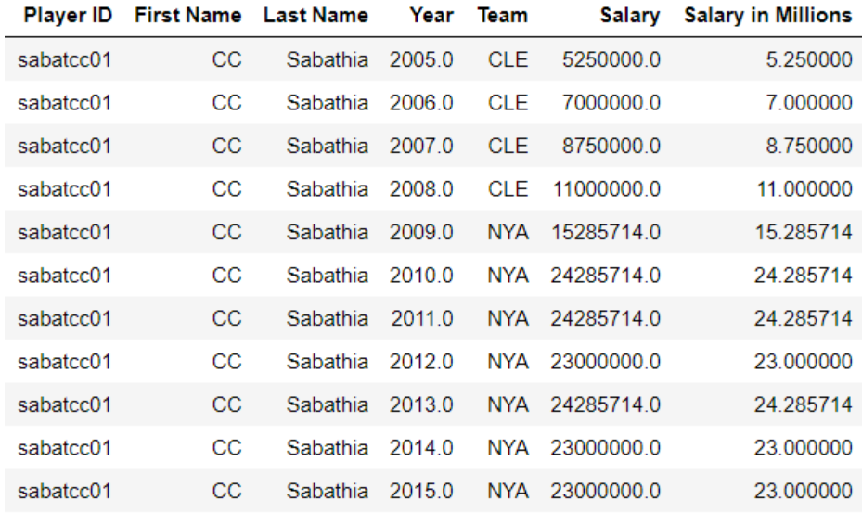
World Series Results and Star Players

Slide 11
Conclusions and Limitations
1) Money isn’t everything in life or baseball, but it sure helps.
2) There are factors outside of our dataset: farm teams, injuries, years outside of timeframe, length of contracts (as well as back and front-end contracts), impact of the managers, power of friendship, etc.
3) The St. Louis Cardinals were a wildly successful team in this time period despite not having the largest budget of the payoff teams. Our data does not identify the “secret sauce" of their success, however.
4) Star players might make a difference, but it’s difficult to isolate the impact of an individual on the entire team. We only identified two instances where a player being added to a team coincided with better team performance.

Slide 12
Questions?

